Slide 1

Time, Clocks, and the Ordering of Events in a Distributed System
Leslie Lamport (1978)
Presented by: Yoav Kantor

Slide 2
Overview
Introduction
The partial ordering
Logical clocks
Lamport algorithm
Total ordering
Distributed resource allocation
Anomalous behavior
Physical clock
?Vector timestamps

Slide 3
Introduction
Distributed Systems
Spatially separated processes
Processes communicate through messages
Message delays are not negligible

Slide 4
Introduction
How do we decide on the order in which the various events happen?
That is, how can we produce a system wide total ordering of events?

Slide 5
Introduction
Use Physical clocks?
Physical clocks are not perfect and drift out of synchrony in time.
Sync time with a “time server”?
The message delays are not negligible.

Slide 6
The Partial Ordering
The relation “→” or “happened before” on a set of events is defined by the following 3 conditions:
I) if events a and b are in the same process and a comes before b then a→b
II) if a is the sending of a message from one process and b is the receipt of that same message by another process then a→b
III) Transitivity: If a→b and b→c then a→c.

Slide 7
The Partial Ordering
“→” is an irreflexive partial ordering of all events in the system.
If a→b and b→a then a and b are said to be concurrent.
a→b means that it is possible for event a to causally affect event b.
If a and b are concurrent, neither can affect the other

Slide 8
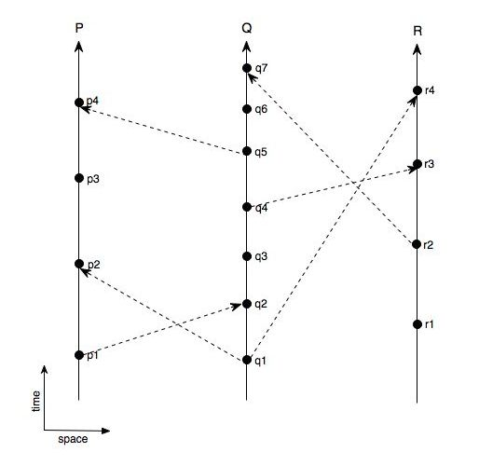
Space time diagram

Slide 9
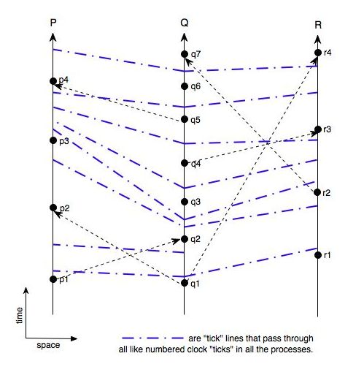
Space time diagram

Slide 10
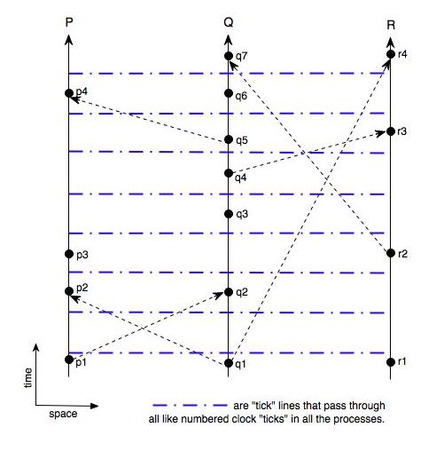
Space time diagram

Slide 11
Logical Clocks
A clock is a way to assign a number to an event.
Let clock C_{i} for every process P_{i} be a function that returns a number C_{i}(a) for an event a within the process.
Let the entire system of clocks be represented by C where C(b) = C_{k}(b) if b is an event in process P_{k}
C is a system of logical clocks NOT physical clocks and may be implemented with counters and no real timing mechanism.

Slide 12
Logical Clocks
Clock Condition:
For any events a and b:
If a→b then C(a) < C(b)
To guarantee that the clock condition is satisfied two conditions must hold:
Cond1: if a and b are events in P_{i} and a precedes b then C_{i}(a) < C_{i}(b)
Cond2: if a is a sending of a message by P_{i} and b is the receipt of that message by P_{k} then: C_{i}(a) < C_{k}(b)

Slide 13
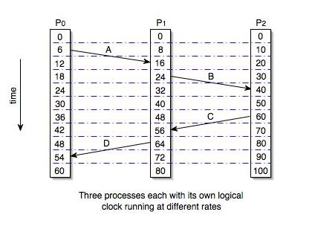
Logical Clocks

Slide 14
Implementation Rules for Lamport’s Algorithm
IR1: Each process increments C_{i} between any two successive events
Guarantees condition1
IR2: If a is the sending of a message m then message m contains a timestamp T_{m} where T_{m} = C_{i}(a)
When a process P_{k} receives m it must set C_{k} to be greater than T_{m} and no less than its current value.
Guarantees condition2

Slide 15
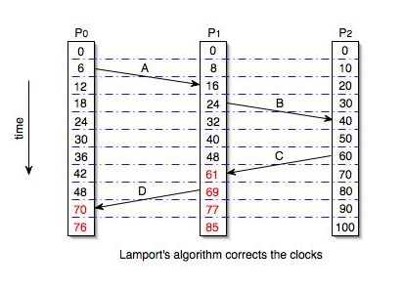
Lamport’s Algorithm

Slide 16
What is the order of two concurrent events?

Slide 17
Total Ordering of Events
Definition: “⇒“ is a relation where if a is an event in a process P_{i} and b is and event in process P_{k} then a⇒b if and only if either:
1) C_{i} (a) < C_{k} (b)
2) C_{i} (a) = C_{k} (b) and P_{i} ? P_{k}
Where: “? “is any arbitrary total ordering of the processes to break ties

Slide 18
Total Ordering of Events
Being able to totally order all the events can be very useful for implementing a distributed system.
We can now describe an algorithm to solve a mutual exclusion problem.
Consider a system of several process that must share a single resource that only one process at a time can use.

Slide 19
Distributed Resource Allocation
The algorithm must satisfy these 3 conditions:
1) A process which has been granted the resource must release it before it can be granted to another process.
2) Requests for the resource must be granted in the order in which they were made.
3) If every process which is granted the resource eventually releases it, then every request is eventually granted.

Slide 20
Distributed Resource Allocation
Assuming:
No process/network failures
FIFO msgs order between two processes
Each process has its own private request queue

Slide 21
Distributed Resource Allocation
The algorithm is defined by 5 rules:
1) To request a resource, P_{i} sends the message T_{m}:P_{i} requests resource to every other process and adds that message to its request queue.
*where T_{m} is the timestamp of the message.
2)When process P_{k} receives the message T_{m}:P_{i} requests resource, it places it on its request queue and sends a timestamped OK reply to P_{i}

Slide 22
Distributed Resource Allocation
3) To release the resource, P_{i} removes any T_{m}:P_{i} requests resource message from its request queue and sends a timestamped P_{i} releases resource message to every other process
4) When process P_{k} receives a T_{m}:P_{i} releases resource message, it removes any T_{m}:P_{i} requests resource message from its request queue

Slide 23
Distributed Resource Allocation
5) P_{i} is granted a resource when these two conditions are satisfied:
I) There is a T_{m}:P_{i} requests resource message on its request queue ordered before any other request by the “⇒“ relation.
II) P_{i} has received a message from every other process timestamped later than T_{m}
Note: conditions I and II of rule 5 are tested locally by P_{i}

Slide 24
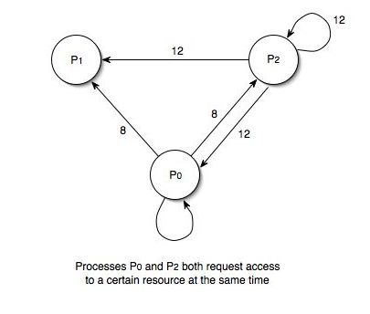
Distributed Resource Allocation
8

Slide 25
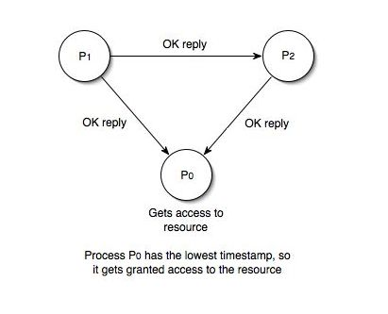
Distributed Resource Allocation

Slide 26
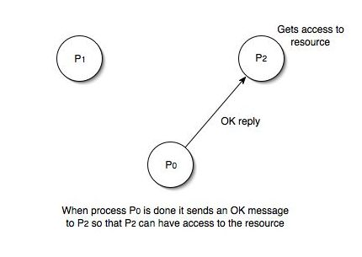
Distributed Resource Allocation
releases resource
releases resource
releases resource msg

Slide 27
Distributed Resource Allocation
Each process follows these rules independently with no central synchronizing process
The synchronization achieved can be considered a State Machine consisting of:
A set of possible commands C
A set of possible states S
A function e: where CxS→S
Each process simulates execution of the state machine

Slide 28
Distributed Resource Allocation
Implications:
Synchronization is achieved because all processes order the commands according to their timestamps using the total ordering relation: ⇒
Thus, every process uses the same sequence of commands
A process can execute a command timestamped T when it has learned of all commands issued system wide with timestamps less than or equal to T
Each process must know what every other process is doing
The entire system halts if any one process fails!

Slide 29
Anomalous Behavior
Ordering of events inside the system may not agree when the expected ordering is in part determined by events external to the system
To resolve anomalous behavior, physical clocks must be introduced to the system.
Let G be the set of all system events
Let G’ be the set of all system events together with all relevant external events

Slide 30
Anomalous Behavior
If → is the happened before relation for G, then let the happened before relation for G’ be “➝”
Strong Clock Condition:
For any events a and b in G’:
If a➝ b then C(a) < C(b)

Slide 31
Physical Clocks
Let C_{i}(t) be the reading of clock C_{i} at physical time t
We assume a continuous clock where C_{i}(t) is a differentiable function of t (continuous except for jumps where the clock is reset).
Thus, dC_{i}(t)/dt ≈1 for all t

Slide 32
Physical Clocks
dC_{i}(t)/dt is the rate at which clock C_{i} is running at time t
PC1: We assume there exists a constant κ << 1 such that for all i: | dC_{i}(t)/dt -1 | < κ
*For typical quartz crystal clocks κ ≤ 10⁻⁶
Thus we can assume our physical clocks run at approximately the correct rate

Slide 33
Physical Clocks
We need our clocks to be synchronized so that C_{i}(t) ≈ C_{k}(t) for all i, k, and t
Thus, there must be a sufficiently small constant ε so that the following holds:
PC2: For all i, k,: | C_{i}(t) - C_{k}(t) | < ε
We must make sure that | C_{i}(t) - C_{k}(t) | doesn’t exceed ε over time otherwise anomalous behavior could occur

Slide 34
Physical Clocks
Let µ be less than the shortest transmission time for inter process messages
To avoid anomalous behavior we must ensure: C_{i}(t +µ) - C_{k}(t) > 0

Slide 35
Physical Clocks
We assume that when a clock is reset it can only be set forward
PC1 implies: C_{i}(t + µ) - C_{i}(t) > (1 - κ)µ
Using PC2 it can be shown that: C_{i}(t + µ) - C_{k}(t) > 0 if ε ≤ (1 - κ)µ holds.

Slide 36
Physical Clocks
We now specialize implementation rules 1 and 2 to make sure that PC2: |C_{i}(t)-C_{k}(t)| < ε holds

Slide 37
Physical Clocks
IR1’: If P_{i} does not receive a message at physical time t then C_{i} is differentiable at t and dC_{i}(t)/dt > 0
IR2’:
A) If P_{i} sends a message m at physical time t then m contains a timestamp T_{m} = C_{i}(t)
B) On receiving a message m at time t’, process P_{k} sets C_{k} (t’) equal to MAX(C_{k}(t’), T_{m} + µ_{m})

Slide 38
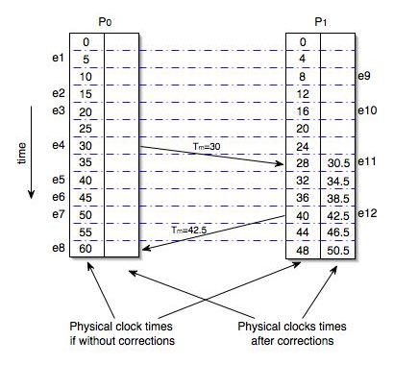
Physical Clocks

Slide 39
Do IR1’ and IR2’ achieve strong clock condition?

Slide 40
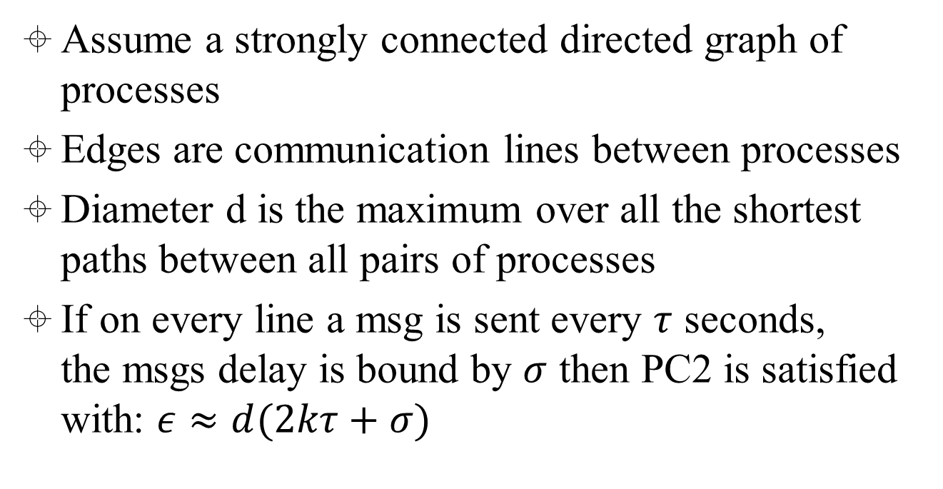
Using IR1’ and IR2’ for achieving PC2
Notes:
𝜎 = t’ - (t+Um)

Slide 41
Lamport paper summery
Knowing the absolute time is not necessary. Logical clocks can be used for ordering purposes.
There exists an invariant partial ordering of all the events in a distributed system.
We can extend that partial ordering into a total ordering, and use that total ordering to solve synchronization problems
The total ordering is somewhat arbitrary and can cause anomalous behavior
Anomalous behavior can be prevented by introducing physical time into the system.

Slide 42
Problem with Lamport Clocks
With Lamport’s clocks, one cannot directly compare the timestamps of two events to determine their precedence relationship.
If C(a) < C(b) we cannot know if a → b or not.
Causal consistency: causally related events are seen by every node of the system in the same order
Lamport timestamps do not capture causal consistency.

Slide 43
Problem with Lamport Clocks
P1
0
P2
0
P3
0
Post m
1
a
e
2
3
Reply m
g
4
b
4
c
5
Clock condition holds, but P2 cannot know he is missing P1’s message
Notes:
that if two events happen without any message, then we can't say anything about their relative occurrence in time.
In this example a <= b <= c <= d <= f, but we can say little about e other than e <= f. We say that events such as a and e are concurrent.
Note also that “happened before” does not demonstrate causality. There is merely the potential for causality.

Slide 44
Problem with Lamport Clocks
The main problem is that a simple integer clock cannot order both events within a process and events in different processes.
The vector clocks algorithm which overcomes this problem was independently developed by Colin Fidge and Friedemann Mattern in 1988.
The clock is represented as a vector [v₁,v₂,…,v_{n}] with an integer clock value for each process (v_{i} contains the clock value of process i). This is a vector timestamp.

Slide 45
Vector Timestamps
Properties of vector timestamps
v_{i} [i] is the number of events that have occurred so far at P_{i}
If v_{i} [j] = k then P_{i} knows that k events have occurred at P_{j}

Slide 46
Vector Timestamps
A vector clock is maintained as follows:
Initially all clock values are set to the smallest value (e.g., 0).
The local clock value is incremented at least once before each send event in process q i.e., v_{q}[q] = v_{q}[q] +1
Let v_{q} be piggybacked on the message sent by process q to process p; We then have:
For i = 1 to n do
v_{p}[i] = max(v_{p}[i], v_{q} [i] );

Slide 47
Vector Timestamp
For two vector timestamps, v_{a} and v_{b}
v_{a} ≠ v_{b} if there exists an i such that v_{a}[i] ≠ v_{b}[i]
v_{a} ≤ v_{b} if for all i v_{a}[i] ≤ v_{b}[i]
v_{a} < v_{b} if for all i v_{a}[i] ≤ v_{b}[i] AND v_{a} is not equal to v_{b}
Events a and b are causally related if v_{a} < v_{b} or v_{b}< v_{a} .
Vector timestamps can be used to guarantee causal message delivery.

Slide 48
causal message delivery using vector timestamp
Message m (from P_{j} ) is delivered to P_{k} iff the following conditions are met:
V_{j}[j] = V_{k}[j]+1
This condition is satisfied if m is the next message that P_{k} was expecting from process P_{j}
V_{j}[i] ≤ V_{k}[i] for all i not equal to j
This condition is satisfied if P_{k} has seen at least as many messages as seen by P_{j} when it sent message m.
If the conditions are not met, message m is buffered.

Slide 49
causal message delivery using vector timestamp
P1
[0,0,0]
P2
[0,0,0]
P3
[0,0,0]
Post m
[1,0,0]
a
[1,0,0]
e
[1,0,0]
c
[1,0,1]
Reply m
g
d
b
[1,0,1]
[1,0,1]
Message m arrives at P2 before the reply from P3 does

Slide 50
causal message delivery using vector timestamp
P1
[0,0,0]
P2
[0,0,0]
P3
[0,0,0]
Post m
[1,0,0]
a
e
[1,0,0]
[1,0,1]
Reply m
g
b
Buffered
[1,0,1]
[1,0,0]
c
Message m arrives at P2 after the reply from P3; The reply is not delivered right away.

Slide 51
Questions?

